Slide 1


JavaMon Capstone
Team 1:
Amanda, Sanju, Zack, Victor

Slide 2
About the Project
JavaMon: a text-based adventure game inspired by Pokémon—initially built by another development team in our cohort.
Our challenge: responsible for complete code review, testing, refactoring, and overhaul—adding new elements and fixing or improving existing features.
Agile mindset: strict 3-day sprints, collaborative team meetings, constant communication, and mock "customer review" sessions.

Slide 3
Highlights
Start screen overhaul.
Internal panel overhaul (prototype on next slide).
Music and sound stings added.
Codex added (history log).
Help box (commands) added.
Environment immersion (interact with objects around player).
Additional Pokémon added.

Slide 4
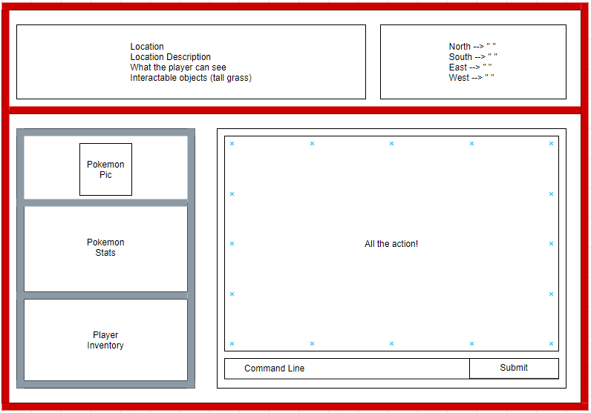

Slide 5
Challenges
Git: lingo, merges, getting started (in general).
OPC (other people's code): working with code not originally written by our team is challenging! Staying focused on the initial "plan" or "purpose" of the program is vital to success.
Scratching heads in confusion: finding out what the code was doing or where things were, and why it existed in the first place.
Bugs: without unit tests in place, bugs were present and readily available to jump out and surprise our team.

Slide 6
Lessons Learned
Pros: working with different people that we hadn't worked with in the past (prior projects or labs); capitalizing on teammate's strengths and reinforcing knowledge and skillset of topics not fully grasped.
Cons: attentive analysis: reading an entire program that you didn't write is challenging (keep logs, notes, and sanity handy—especially in the beginning!). Technical enabling: bug, feature, or problem that has nothing to do with user story goals and draws attention from multiple developers (distraction).

Slide 7
What Would Be Next?
Pokémon
Wild Pokémon Battles
Locations
Final Battles (Elite 4/Champion)
Immersion
XP requirements (advancement)
Rare spawns
Evolving
Larger Map
More Cities
Combat animations
Musical queues
Poke balls (capture)
Secrets
Flying (teleport)

Slide 8
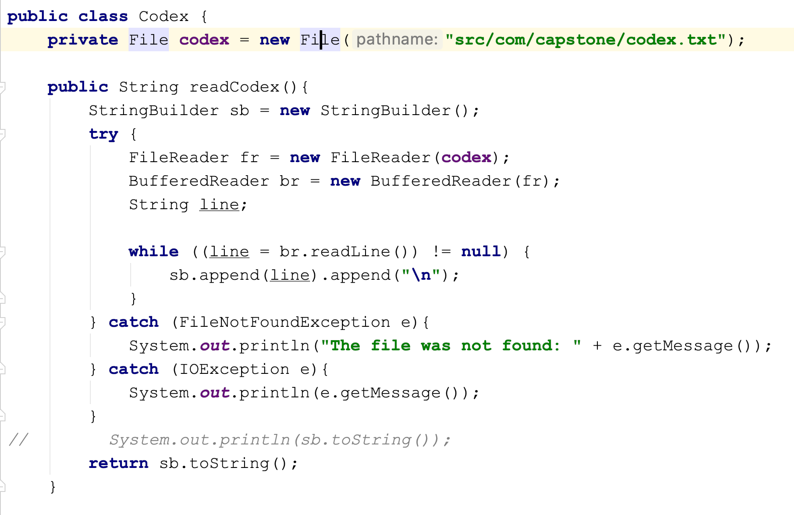
Code Input (Amanda)

Slide 9
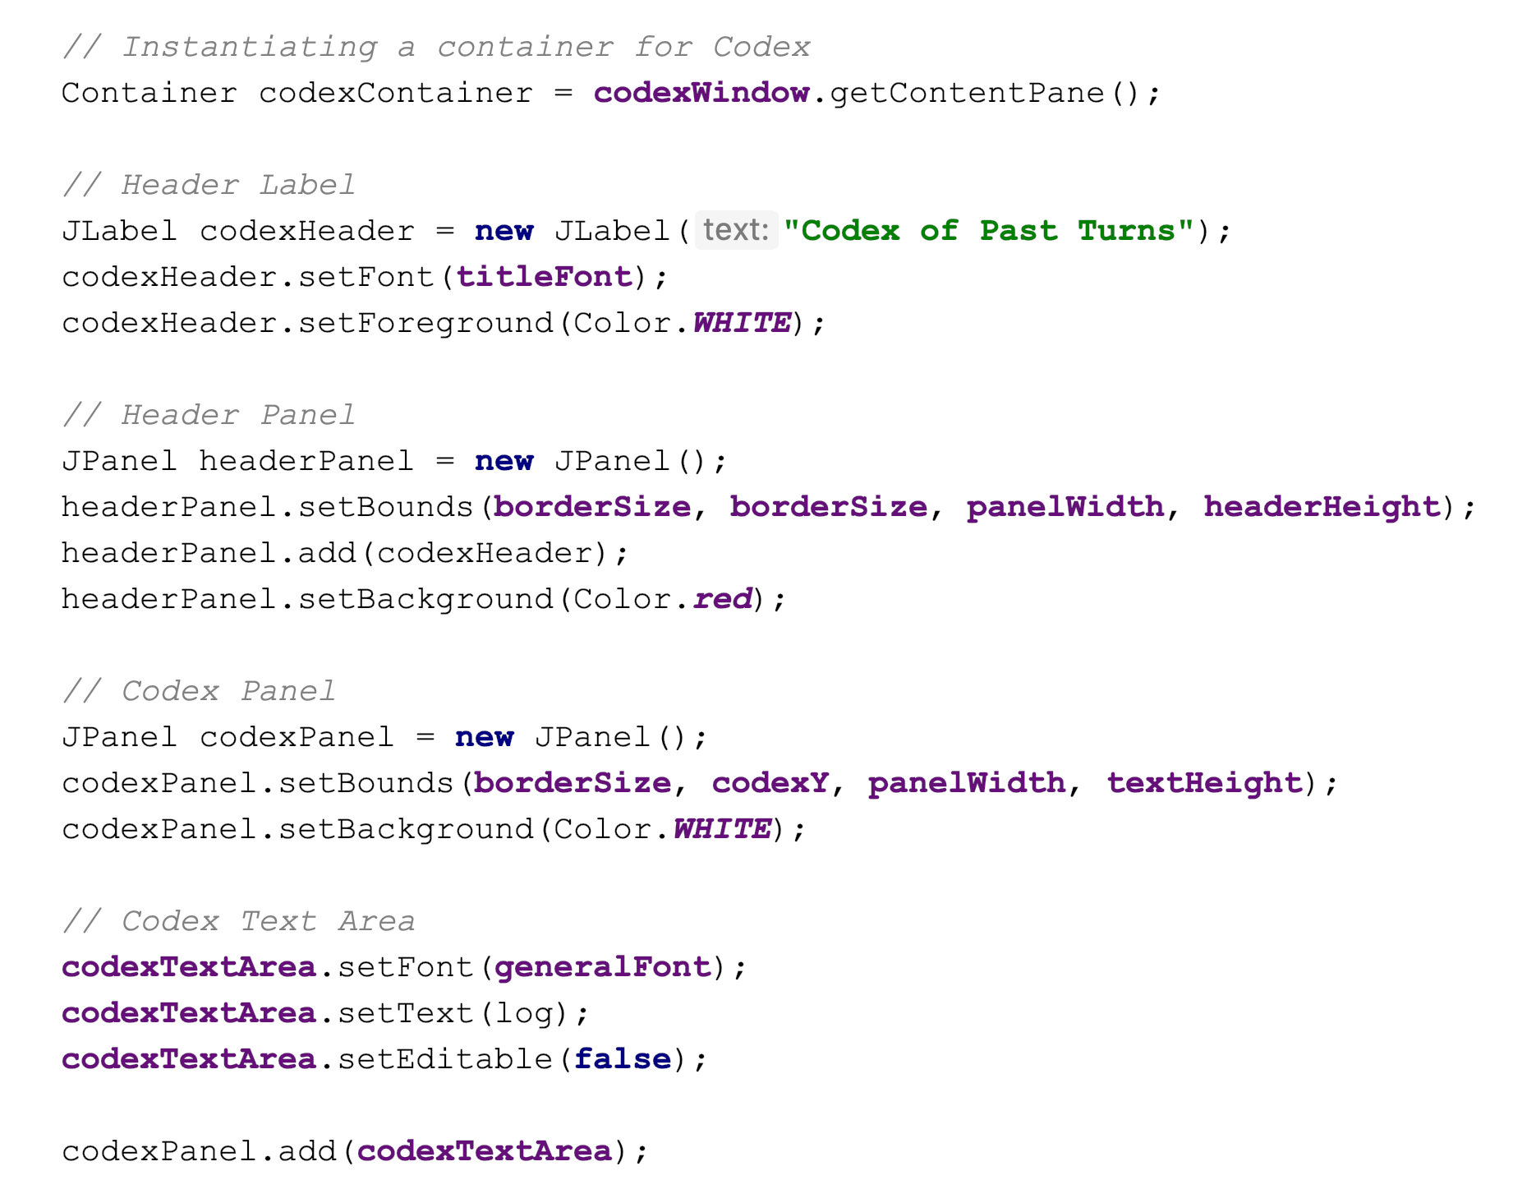

Slide 10
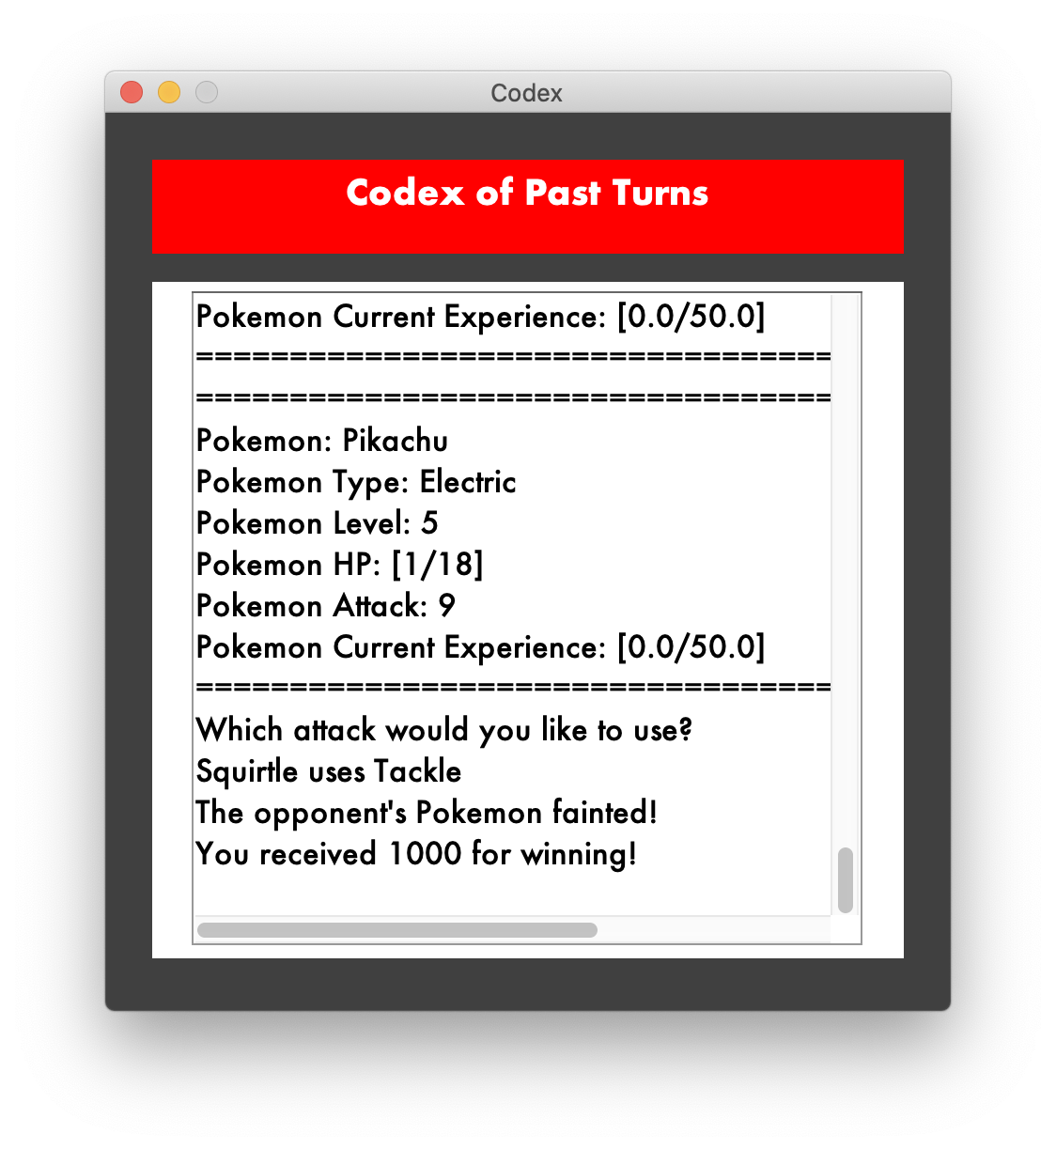

Slide 11
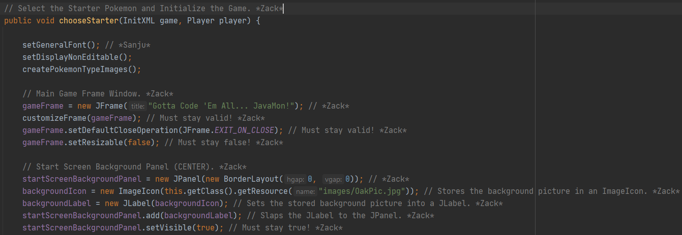
Code Input (Zack)

Slide 12
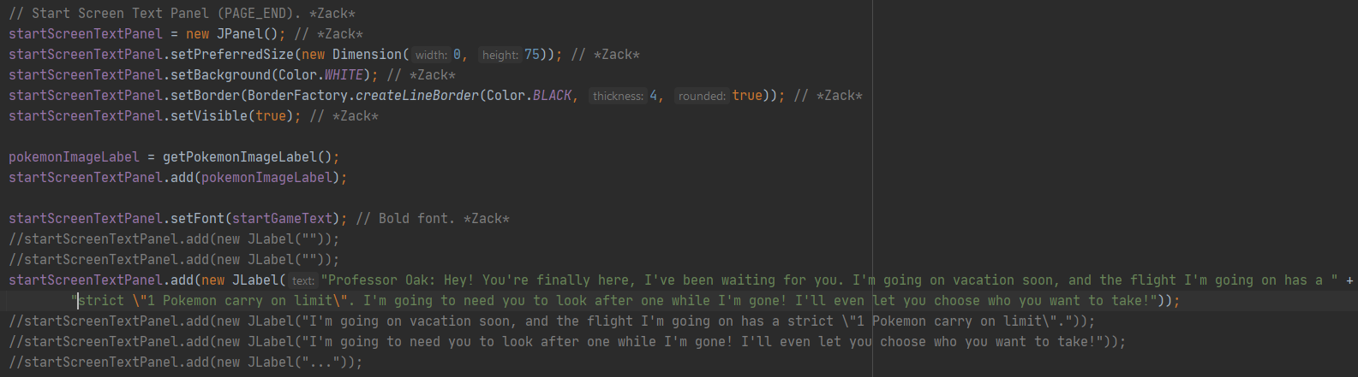

Slide 13
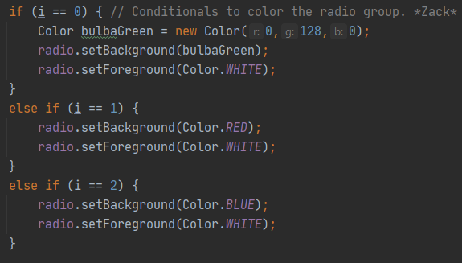
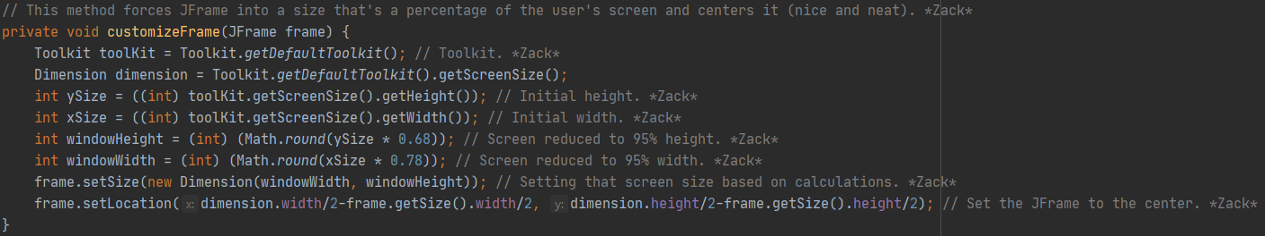

Slide 14
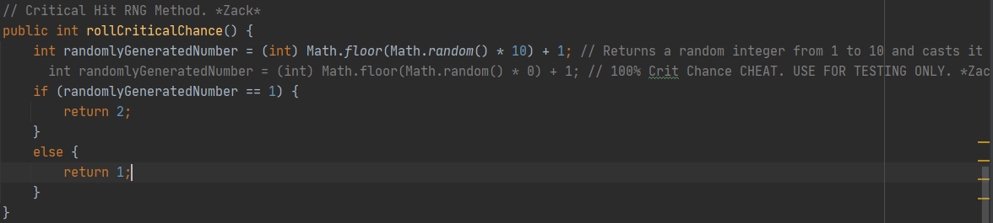
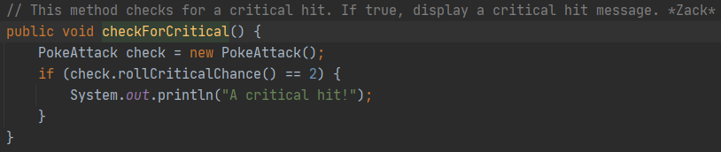

Slide 15
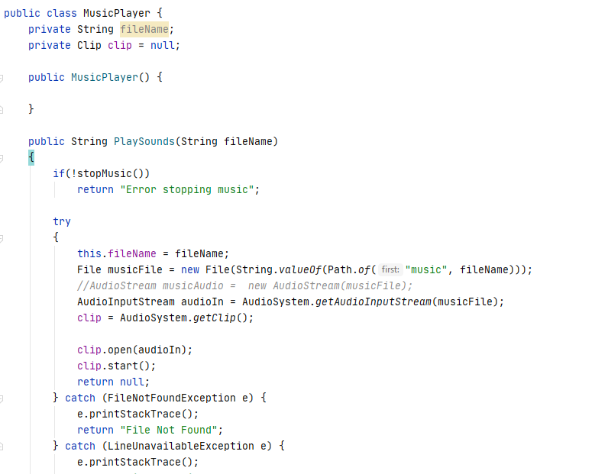
Code Input (Victor)

Slide 16
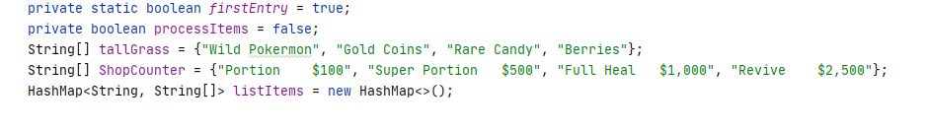

Slide 17
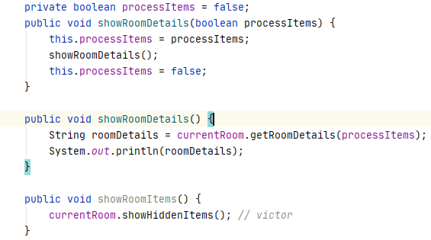

Slide 18
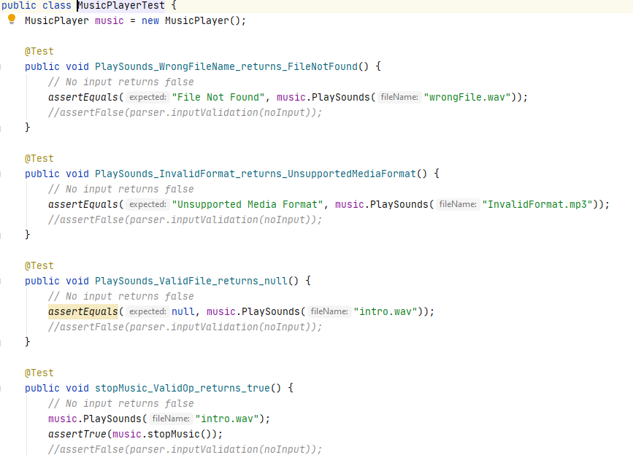

Slide 19
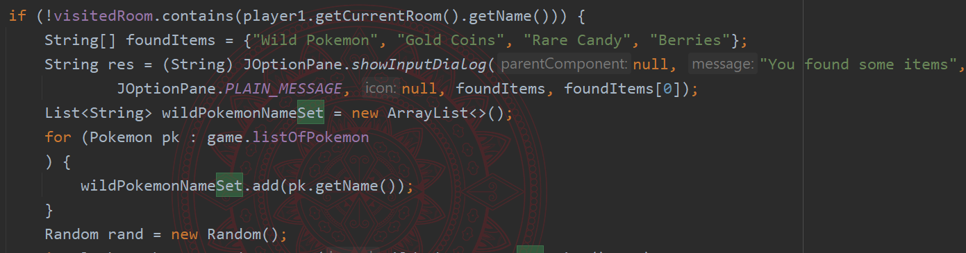
Code Input (Sanju)

Slide 20
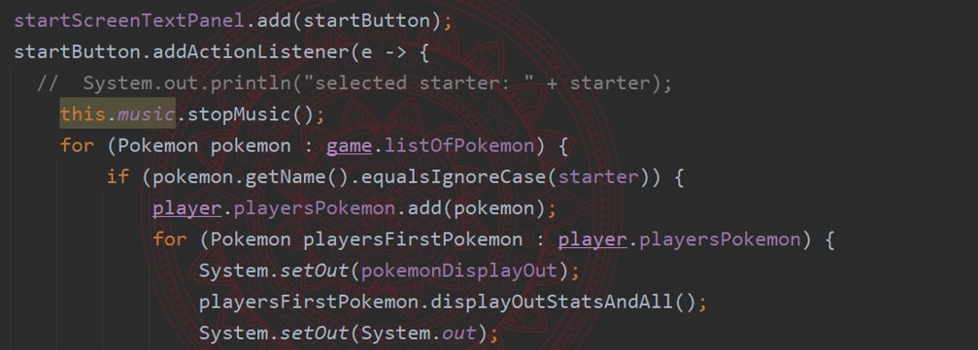

Slide 21
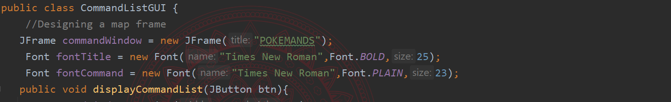

Slide 22
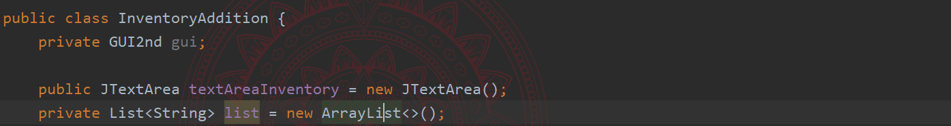

Slide 23
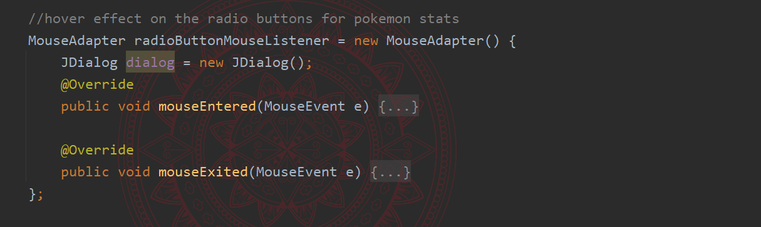

Slide 24
Game Walkthrough
“Give me six hours to chop down a tree and I will spend the first four sharpening the axe.”
– Abraham Lincoln

